Slide 1

Your past, your present and your future

Slide 2


Slide 3


Slide 4
Overview
Idea
Technologies
Competitors
Costs
Team
Planification
Demo
Piloting plan

Slide 5
IDEA
What is Capsulefy?

Slide 6





Time capsule

Slide 7


Payment plans
 | Free | Premium
Price | 0 € | 11.99 €
Storage | 20 MB/user | 500 MB/capsule
Social network and email integration
Capsule scheduling | 1 year | No limit
Capsule expiration | 6 months after release | No expiration
Modular and private capsules

Slide 8
Quality (p) | MB/minute
144 | 1.3
240 | 3.3
360 | 5
480 | 8.3
720 | 25
1080 | 50

Slide 9
TECHNOLOGIES
What stack do we use?

Slide 10





Web app
Users and capsules
Media storage
Social networks

Slide 11


Testing
Functional and integration
Performance
Coverage

Slide 12





Slide 13
COMPETITORS
What makes us different?

Slide 14
 | Viajeros en el tiempo | Mytimecapsule | Miigen | thetimecapsule | Capsulefy
Automatic content publication
Free plan
Premium plan
Images
Videos
Social network integration
Deadman switch

Slide 15
COSTS
How much does Capsulefy cost?

Slide 16


Realistic | 29968.20 – 31330.29 €
Optimistic | 28061.13 €
Pesimistic | 34054.77 €
Project duration: 4 months

Slide 17
Project duration | 4 months
Salaries | 20.80 €/hour
Hours per month | 40
Amortization | 60 months
Equipment | 306.67 €
Hosting (1 year) | 669.34 €
Advertising (6 months) | 3060 €
Risk prevention | 10% (2724.38 €)
Total | 29968.20 €

Slide 18
TEAM
Who is behind?

Slide 19
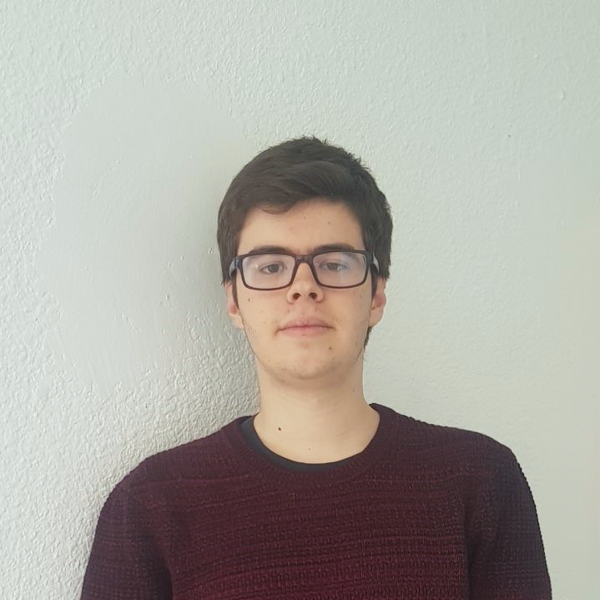
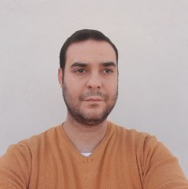




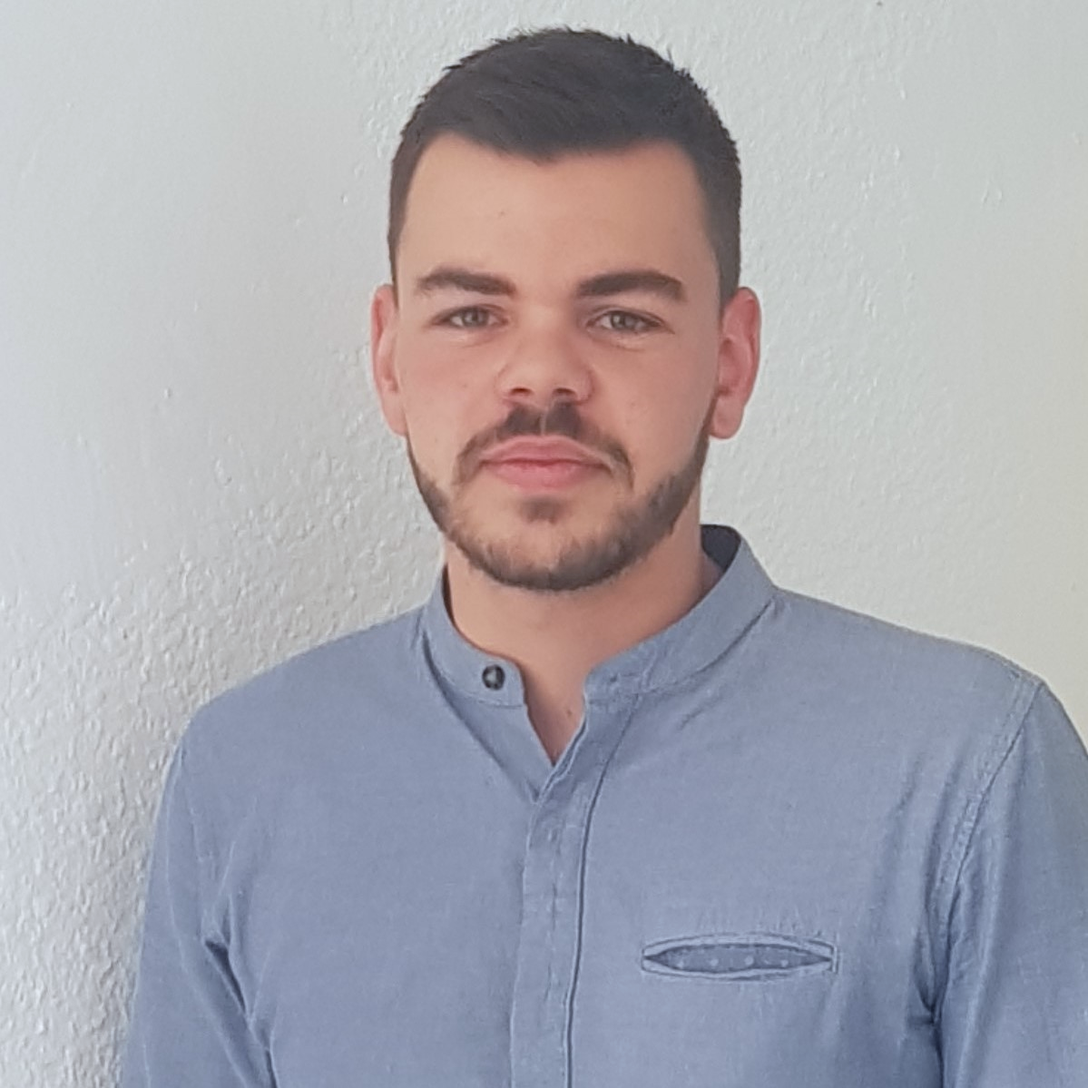
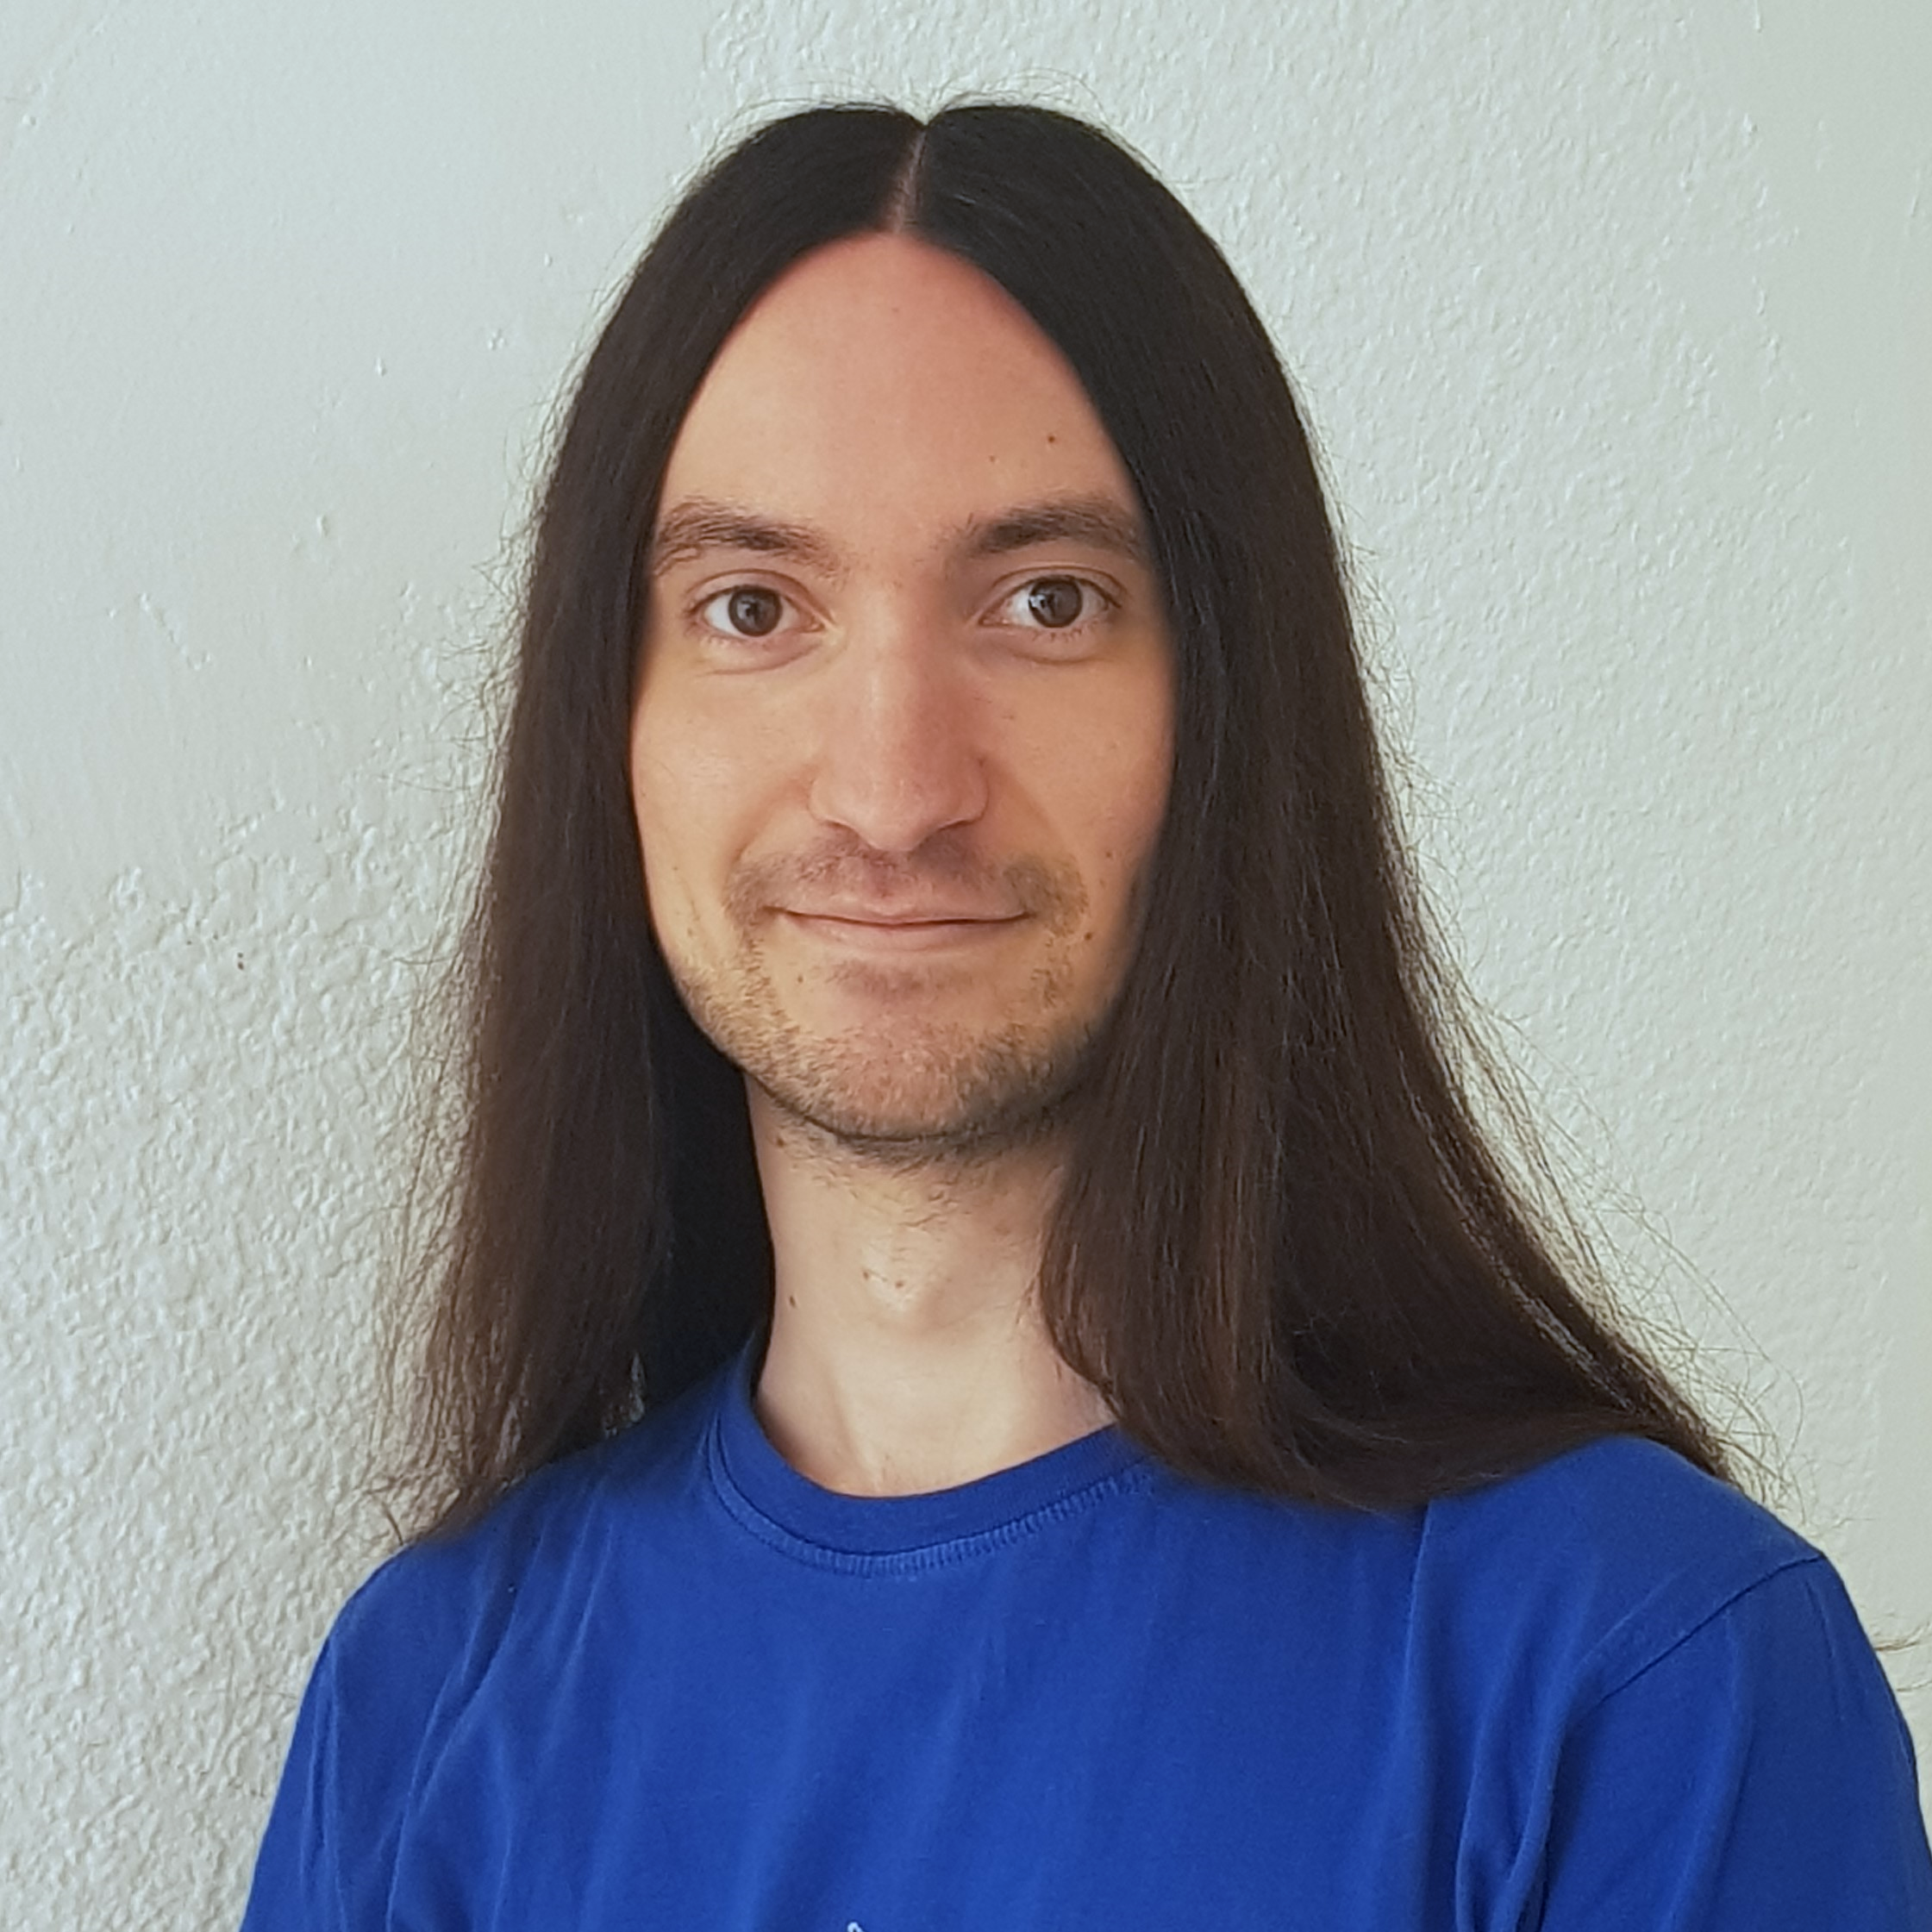


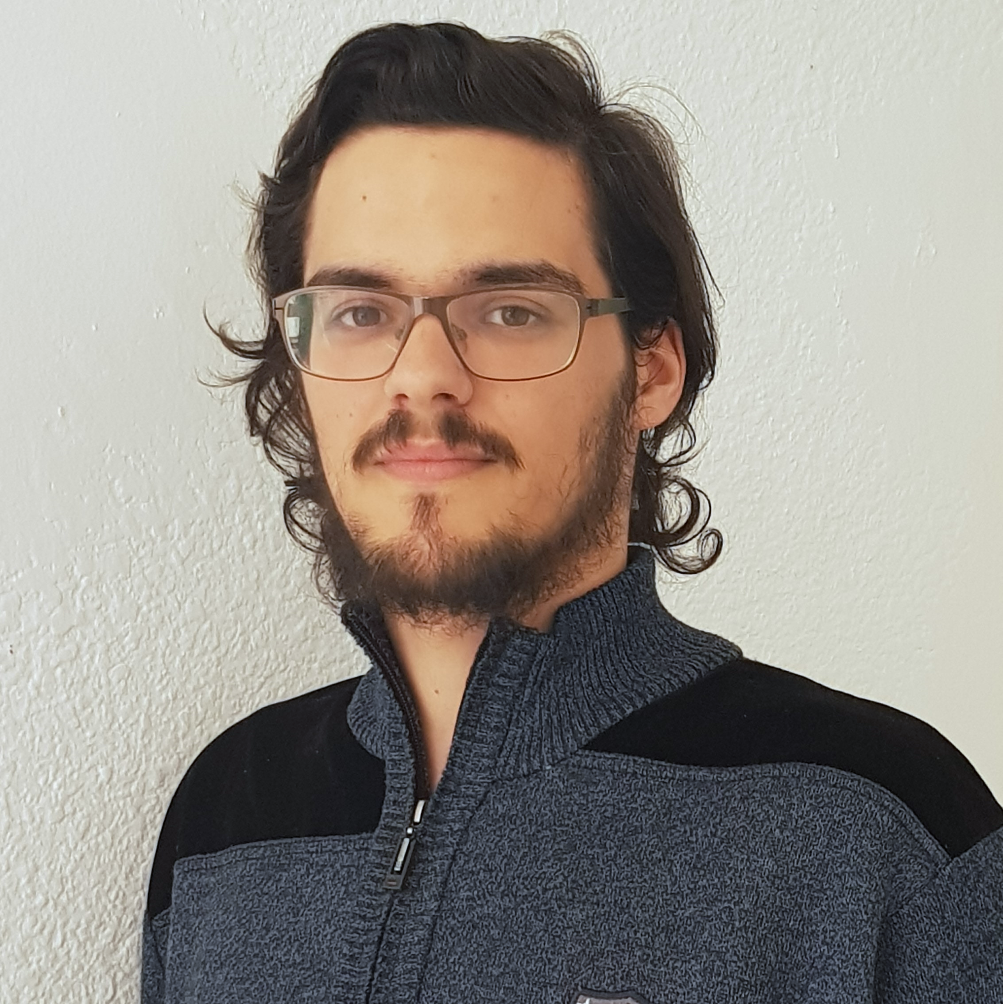



Pablo Rebollo
Project manager, backend developer
Juan Rodríguez
Requirements engineer, backend developer
Adrián Cantón
Business manager, full-stack developer
Rafael Fresno
Backend developer, API integration
Daniel Carpio
Analist,
frontend developer

Slide 20
PLANIFICATION
How do we organize development?

Slide 21
First sprint March 18th – March 29th | Core use cases Piloting plan
Second sprint April 1st – April 12th | Full MVP Feedback taken into account
Third sprint April 22nd – May 3rd | Polished MVP

Slide 22




Performance indicator
$$avg(\frac{Estimated time}{Invested time})$$
~
>= 0.5
< 0.8
>= 0.8
<= 1.2
> 1.2
<= 1.5
!
?
< 0.5
> 1.5

Slide 23



Factors affecting performance
Optimistic estimation
Wasted time
Difficulties
Pesimistic estimation
Easier tasks
Unknown technology

Slide 24



General solutions
Talk
Reschedule
Balance
Monitor

Slide 25
SPRINT 2 WEEK 1
April 1st – April 7hth

Slide 26
Task | Assign. | Start | End | Est. (h) | Inv. (h)
Initial meeting | All | Apr 1 | Apr 1 | 1.5 | 1.5
Local settings | Daniel | Apr 2 | Apr 2 | 1 | 0.5
User registration | Juan | Apr 2 | Apr 2 | 2 | 2
Remove expired capsules | Pablo | Apr 2 | Apr 2 | 1.5 | 1.5
Twitter integration | Rafael | Apr 2 | Apr 4 | 4 | 4
Update modular form | Adrián | Apr 2 | Apr 3 | 5 | 6
Fix pagination issues | Juan | Apr 3 | Apr 3 | 1.5 | 1.5
DM switch notifications | Pablo | Apr 3 | Apr 4 | 1.5 | 2
UI: Registration | Daniel | Apr 3 | Apr 4 | 0.5 | 0.25
TIME

Slide 27
Task | Assign. | Start | End | Est. (h) | Inv. (h)
Ban users | Juan | Apr 4 | Apr 6 | 2 | 1.5
UI: User account | Daniel | Apr 4 | Apr 6 | 1.5 | 1.25
Automation improvements | Pablo | Apr 4 | Apr 7 | 4 | 4.5
Basic payment | Adrián | Apr 5 | Apr 7 | 4 | 4
Presentation | Rafael | Apr 5 | Apr 7 | 3 | 3
UI: List and search users | Daniel | Apr 6 | Apr 7 | 2 | 2
Rehearsal | Pablo | Apr 7 | Apr 7 | 1.5 | 1
TIME

Slide 28
Unplanned tasks
Task | Assignees | Invested time (h)
Travis test problems | Daniel | 1.5
Check DM switch when editing capsules | Daniel | 0.25
Fix AJAX search | Juan | 0.5
Add tooltip for notification emails | Daniel | 1
Improve registration form | Daniel | 2

Slide 29
 |  | April
Task | Assignees | 1 | 2 | 3 | 4 | 5 | 6 | 7
Initial meeting | All
Local settings | Daniel
User registration | Juan
Remove expired capsules | Pablo
Twitter integration | Rafael
Update modular form | Adrián
Fix pagination issues | Juan
DM email notifications | Pablo

Slide 30
 |  | April
Task | Assignees | 1 | 2 | 3 | 4 | 5 | 6 | 7
UI: Registration | Daniel
Ban users | Juan
UI: User account | Daniel
Automations | Pablo
Basic payment | Adrián
Presentation | Rafael
UI: List and search users | Daniel
Rehearsal | Pablo

Slide 31
Performance
Adrián | 0.94
Daniel | 1.44
Rafael | 1
Pablo | 1.02
Juan | 1.08

Slide 32


What actions did we take?
Performance ratio
Invested hours
Up to 6 hours
Maximum delay
Up to 2 days
Invested days
Up to 6 days
Divide tasks

Slide 33

Metric results
Performance ratio
Invested hours
Min: 0.94
Max: 6
Maximum delay
Invested days
Divide tasks
Max: 2
Max: 5

Slide 34

What actions did we take?
Last week: 1 wiki entry
Today: 5 wiki entries
Better tool usage

Slide 35


What went wrong?
- What happened?
Django 2.2 broke our tests.
- Solution
Migrate to Django 2.2 and fix
all tests.
Django update

Slide 36



What went wrong?
- What happened?
Late deployment led to many
errors.
- Solution
Deploy 2 days before deadline.
Deployment
problems

Slide 37
DEMO
How does the system look like?

Slide 38
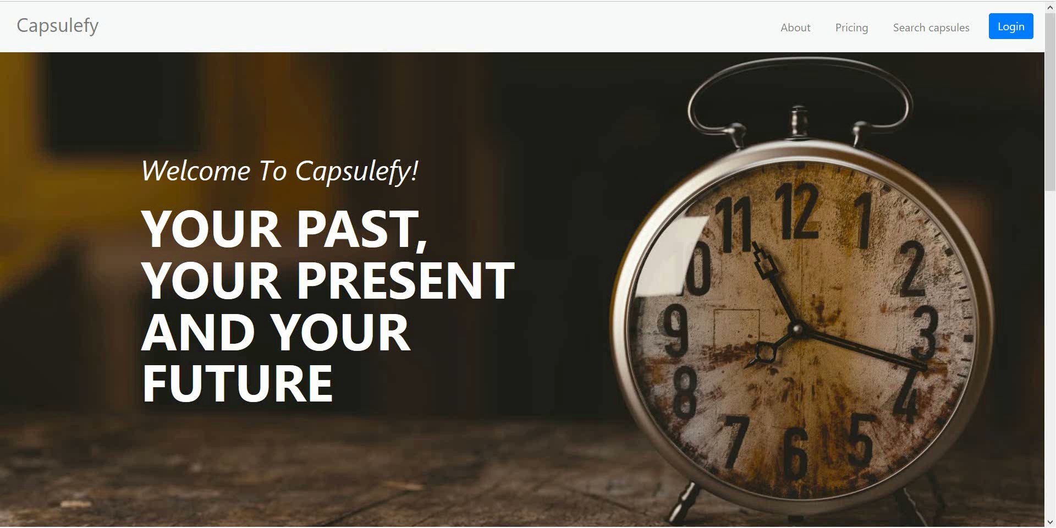
No logged user – List, search and display capsules

Slide 39
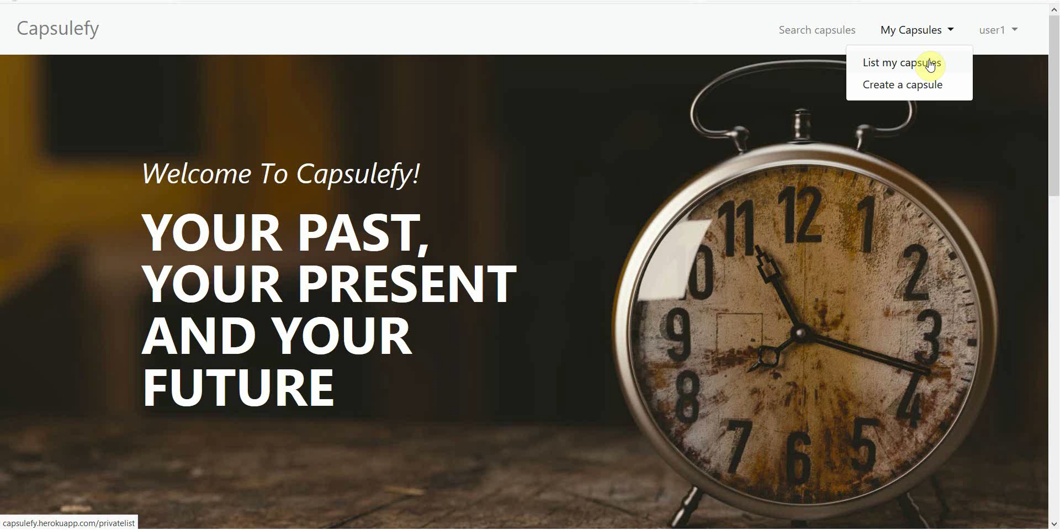
Logged-in user – Create premium capsule

Slide 40
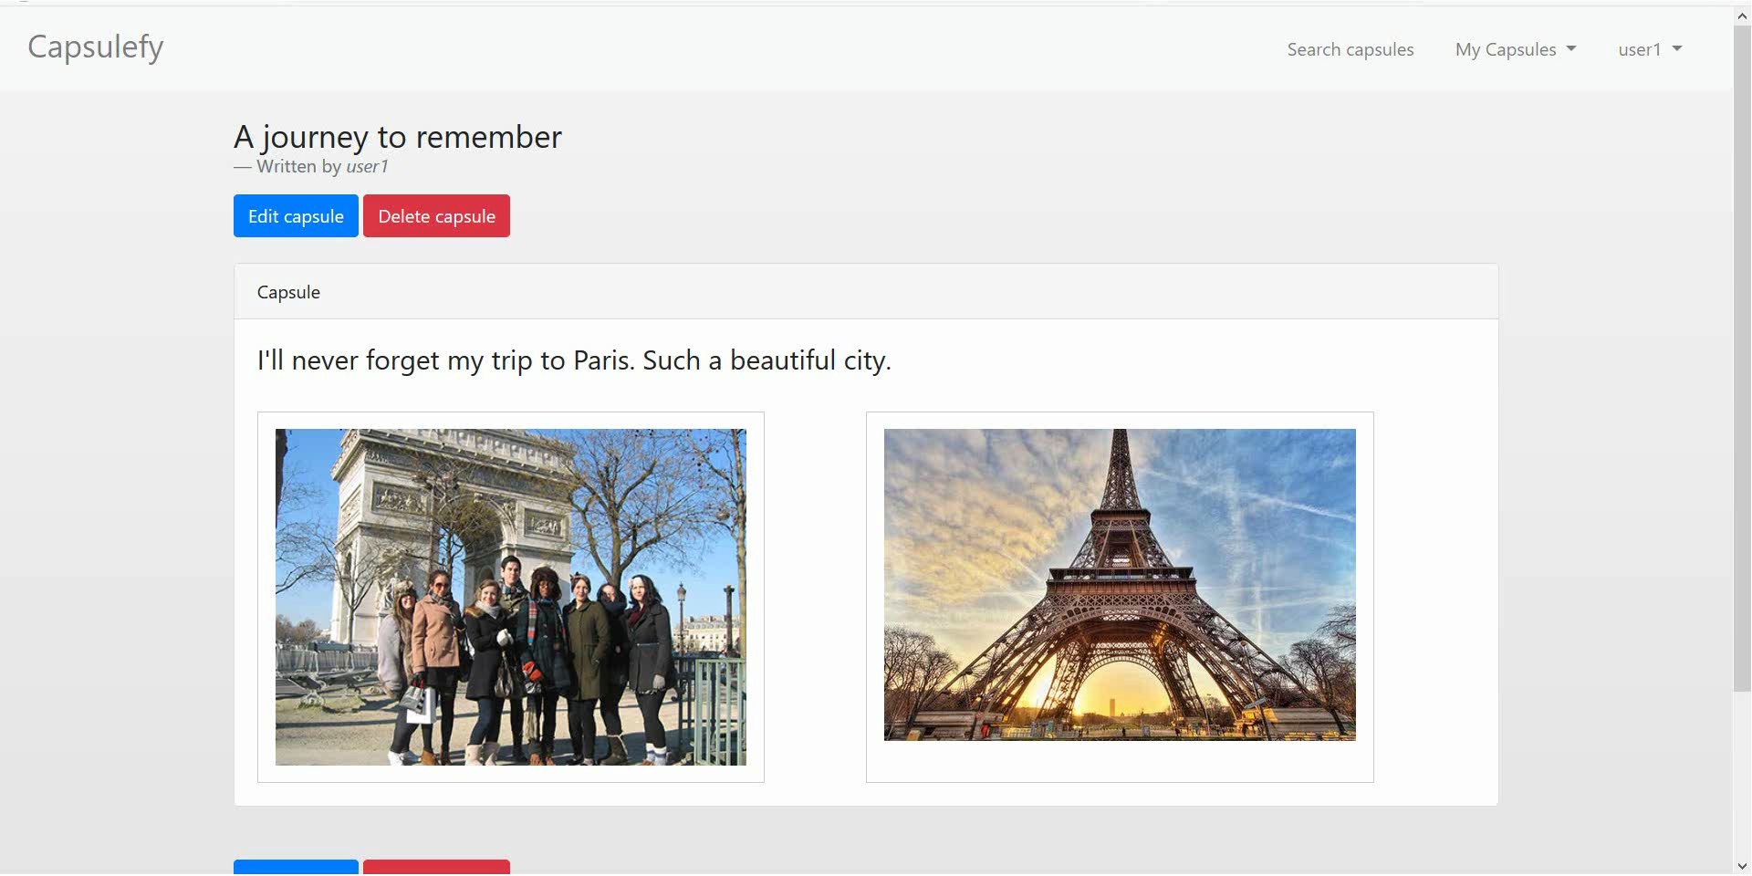
Logged-in user – Add and delete modules

Slide 41
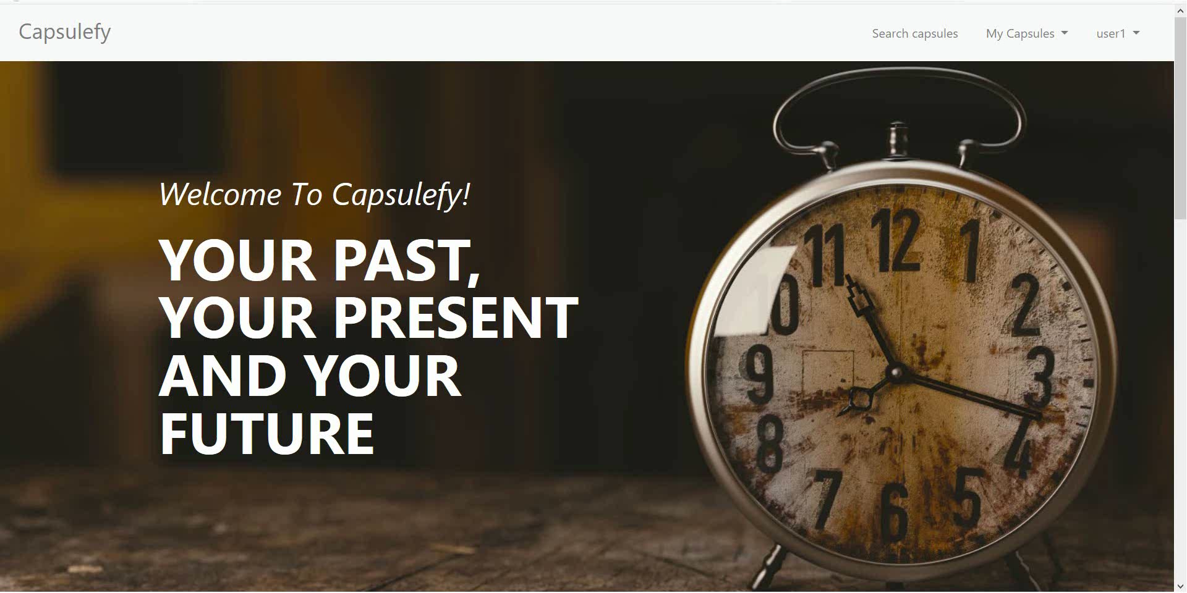
Logged-in user – Add and delete modules

Slide 42
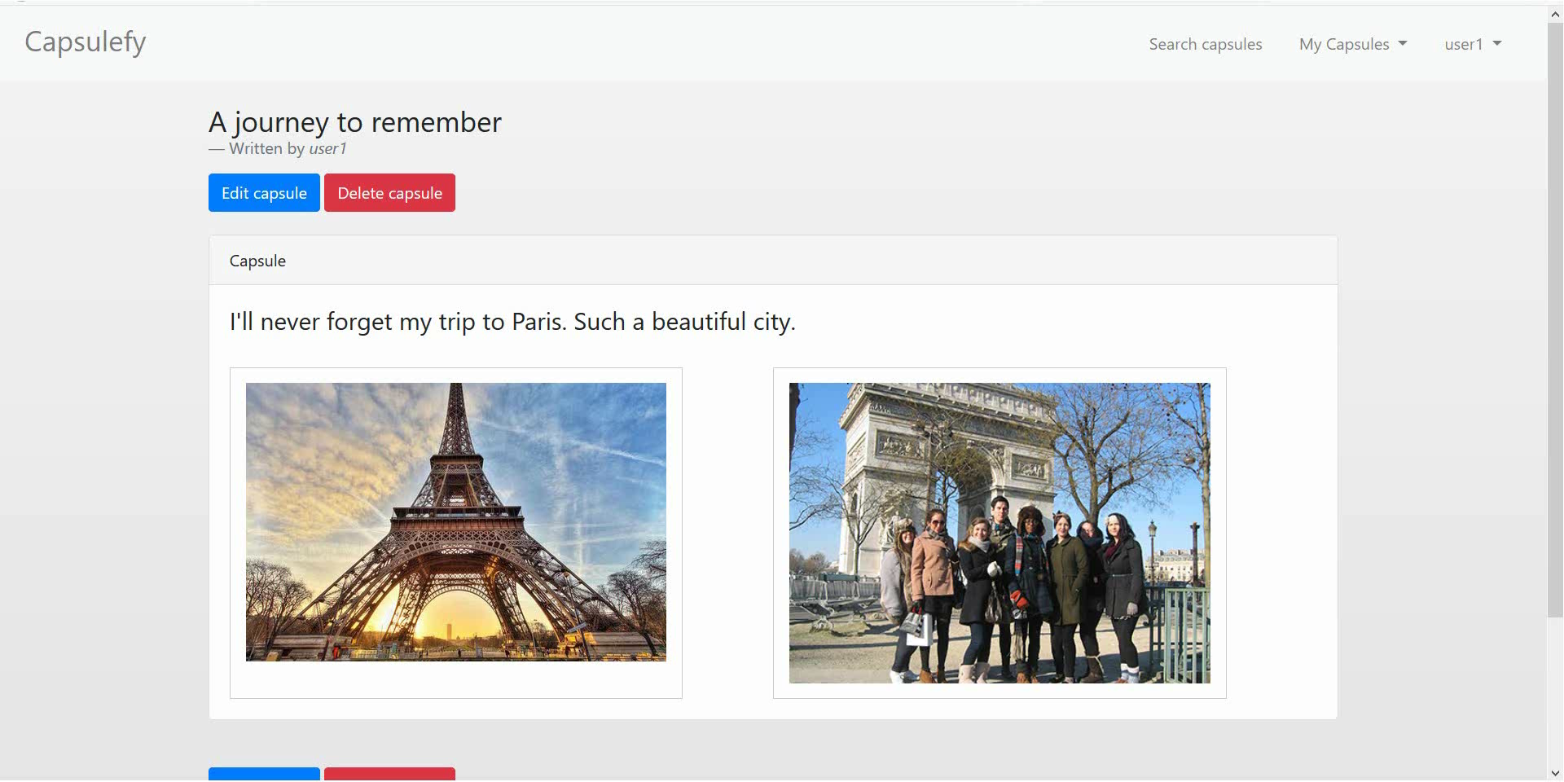
Logged-in user – Add and delete files

Slide 43
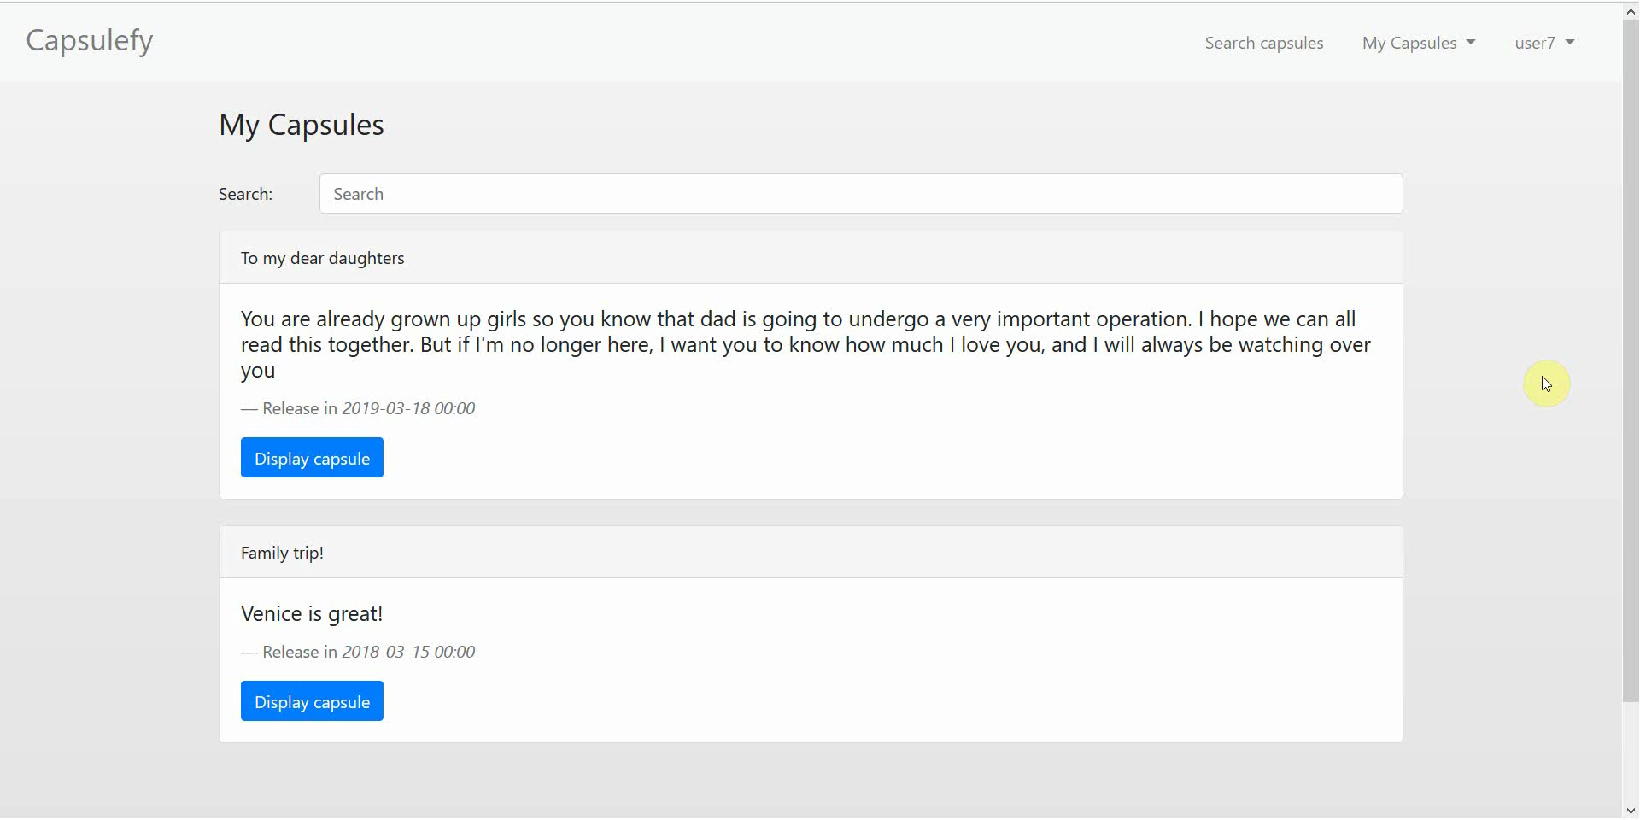
Logged-in user – Refresh capsules

Slide 44
SPRINT 2 WEEK 2
April 8th – April 12th

Slide 45

Note
The following planification may change during today’s meeting!

Slide 46
Task | Assignees | Start | End | Est. (h)
Feedback meeting | All | Apr 8 | Apr 8 | 1.5
User interface | Daniel | Apr 9 | Apr 11 | 7
Facebook integration | Rafael | Apr 9 | Apr 11 | 4
Premium payments | Adrián | Apr 9 | Apr 10 | 4
Admin dashboard | Juan | Apr 9 | Apr 10 | 3
Jmeter performance tests | Pablo | Apr 9 | Apr 11 | 4
SonarCloud set up | Adrián | Apr 11 | Apr 12 | 3
Edit notification email | Juan | Apr 11 | Apr 11 | 2
TIME

Slide 47
Task | Assignees | Start | End | Est. (h)
Sprint review Sprint 3 planification | All | Apr 11 | Apr 11 | 1.5
Presentation | Rafael | Apr 11 | Apr 12 | 3
Deliverable | Pablo | Apr 11 | Apr 12 | 4
TIME

Slide 48
 |  | April
Task | Assignees | 8 | 9 | 10 | 11 | 12
Feedback meeting | All
User interface | Daniel
Facebook integration | Rafael
Premium payments | Adrián
Admin dashboard | Juan
Jmeter performance tests | Pablo
SonarCloud set up | Adrián
Edit notifications email | Juan

Slide 49
 |  | April
Task | Assignees | 8 | 9 | 10 | 11 | 12
Sprint review Sprint 3 planification | All
Presentation | Rafael
Deliverable | Pablo

Slide 50
PILOTING PLAN
How will users test Capsulefy?

Slide 51




Create manual
Create test suite
Test the system
Gather feedback
Fill form

Slide 52
Committed users
Name | Age
Francisco R. | 55
Javier A. | 19
Valentin A. | 19
Antonio G. | 26
Name | Age
José Manuel J. | 21
Sandra C. | 28
José Manuel C. | 21

Slide 53
Sprint 2
Users receive and fill form
March 30 – April 6
Development
April 8 – April 12
Receive users feedback
April 6
Planification
April 8

Slide 54
FIRST FEEDBACK RESULTS
What did users say?

Slide 55

Capsule search and display
“Minimalistic and intuitive”
“Simple”
“Interesting”
“I would add more colors”
“Long loading time and no back button”

Slide 56
Free capsules
“No confirmation on deletion”
“Some images do not load”
“Interesting and easy”
“No easy date picker”
“Comfortable and fast”

Slide 57
Premium capsules
“Much better tan free capsules”
“Confusing names on display”
“I could not delete a module”
“Perfect, no errors”
“Not much more useful tan free capsules”

Slide 58
Conclusions
“Maybe sell merchandising?”
“It is missing some contextual help”
“I would change the colors”
“Innovative and interesting”
“It goes to the point”

Slide 59
Sprint 3
Easter Week
Users receive and fill form
April 12 – April 22
Development
April 22 – May 3
Receive users feedback
April 22
Planification
April 22

Slide 60
After development
Users receive and fill form
May 4 – May 12
Receive users feedback
May 12
Planification
May 13

Slide 61
Documentation
Manual (PDF)
Test suite
Form
https://forms.gle/DWs2JPuyyd8hnbjg6

Slide 62
Thanks!
Upstream: https://capsulefy.herokuapp.com
Sprint 1: https://capsulefy02.herokuapp.com
capsulefy.communications@gmail.com
Pilot users form: https://forms.gle/DWs2JPuyyd8hnbjg6
GitHub releases: https://github.com/pabreblob/capsulefy/releases

Slide 63


Deadman switch
ON

Slide 64



Teamwork
Skills
Profitable work
Positive feedback

Slide 65


Risk | Mitigation
Broken computer | Risk prevention funds
Changing terms of use | Monitor
Servers down | Monitor
Incompatible timetables | Reschedule

Slide 66
Year 1: 2000 sales
Balance: -10168 €
Year 2: 4000 sales
Balance: 16273 €
29968 €
39600 €
19800 €
13159 €
Costs
Earnings
Costs
Earnings

Slide 67
Year 3: 8000 sales
Balance: 81450 €
79200 €
14023 €
Costs
Earnings

Slide 68

Monthly advertising costs
220 €
140 €
150 €

Slide 69
SPRINT 1 WEEK 1
March 18th – March 22nd

Slide 70
Task | Assignees | Est. (h) | Inv. (h) | Status
Data model | Adrián, Daniel | 4 | 1.5 | Finished
Set up environment | All | 2.5 | 2.5 | Finished
Angular research | Daniel | 1 | 2 | Aborted
Data model implementation | Juan | 2.5 | 2 | Finished
Populate database | Pablo | 2 | 3.2 | Finished
Basic capsule CRUD | Rafael | 2.5 | 9 | To be tested
Display capsules | Adrián | 2 | 5 | To be tested
TIME

Slide 71
Task | Assignees | Est. (h) | Inv. (h) | Status
Listing capsules | Juan | 1.5 | 1 | To be tested
User login | Juan | 1 | 1 | To be tested
Advertisement budget | Pablo | 1.5 | 1.5 | Finished
User interface | Daniel | 1 | 10 | Finished
Documentation | Daniel, Adrián, Juan | 1.5 | 1.5 | Finished
Presentation | Pablo, Rafael | 3 | 4 | Finished
Review meeting | All | 2.5 | 2.5 | Finished
TIME

Slide 72
Performance
Adrián | 1.34
Daniel | 1.05
Rafael | 0.67
Pablo | 0.84
Juan | 1.06

Slide 73

What went wrong?
No Angular knowledge
Bad estimations
Lack of time

Slide 74
SPRINT 1 WEEK 2
March 25th – March 29th

Slide 75
Task | Assignees | Est. (h) | Inv. (h) | Status
Feedback meeting | All | 5 | 5 | Finished
Travis CI set up | Adrián, Rafael | 2 | 3 | Finished
Modular capsules | Adrián | 5 | 4.5 | Finished
Private capsules | Juan | 2 | 1.5 | Finished
Email automation | Juan | 2 | 1.5 | Finished
Search capsules | Daniel | 1.5 | 1 | Finished
List own capsules | Juan | 1 | 1 | Finished
Pagination | Juan | 1 | 3 | Finished
TIME

Slide 76
Task | Assignees | Est. (h) | Inv. (h) | Status
Deadman switch | Pablo | 4 | 5 | Finished
Social network integration | Rafael | 4 | 1 | Postponed
User interface | Daniel | 4 | 7 | Finished
Piloting plan | Adrián | 2.5 | 1 | Finished
Sprint meeting | All | 5 | 5 | Finished
Documentation | Adrián, Daniel, Juan | 1.5 | 1.5 | Finished
Presentation | Rafael | 3 | 5.5 | Finished
Deliverable | Pablo | 3 | 4 | Finished
TIME

Slide 77
Performance
Adrián | 1.32
Daniel | 1.03
Rafael | 0.60
Pablo | 0.77
Juan | 0.87

Slide 78
What went wrong?
Performance further reduced
Implementation differences
Lack of time

Slide 79
What actions were taken?
Meet
Reschedule
Reestimate

Slide 80
Total performance
Adrián | 1.31
Daniel | 1.02
Rafael | 0.63
Pablo | 0.80
Juan | 0.96

Slide 81

Taken actions
Detailed planning
Time for documentation
Better tool usage
Divide tasks

Slide 82
SPRINT 1 RESULTS
What was produced?

Slide 83
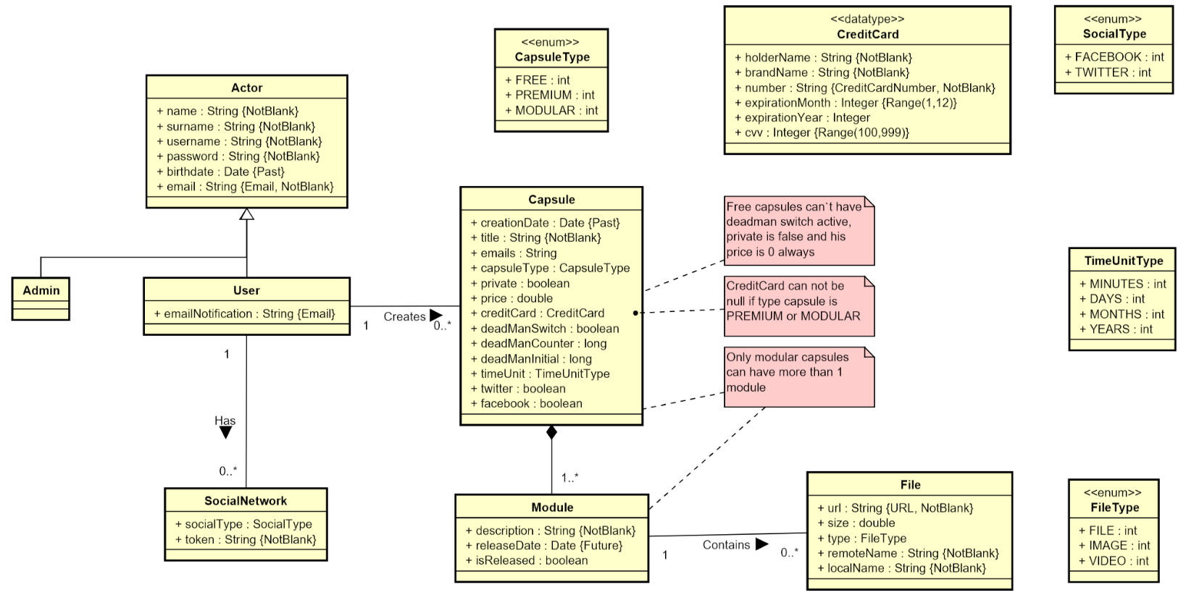

Slide 84
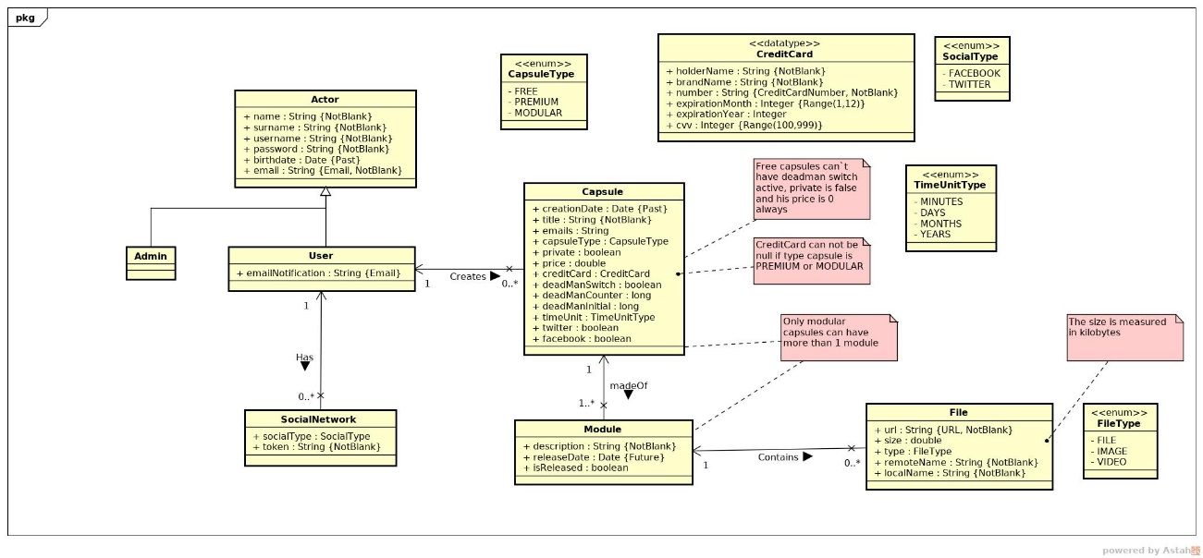

Slide 85
Documentation
Sprint 1 documentation
Piloting plan
Development
Frozen app: https://capsulefy02.herokuapp.com
GitHub release: https://github.com/pabreblob/capsulefy/releases

Slide 86
Project duration | 7 weeks (2 development)
Salaries | 20.80 €/hour
Hours per month | 40
Total salaries | 6989 €
Amortization | 60 months
Equipment | 134.16 €
Hosting | 0 €
Advertising | 0 €
Total | 7123.16 €

